Slide 1
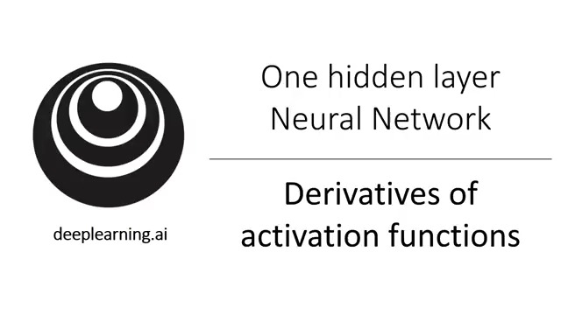
Derivatives of activation functions

Slide 2
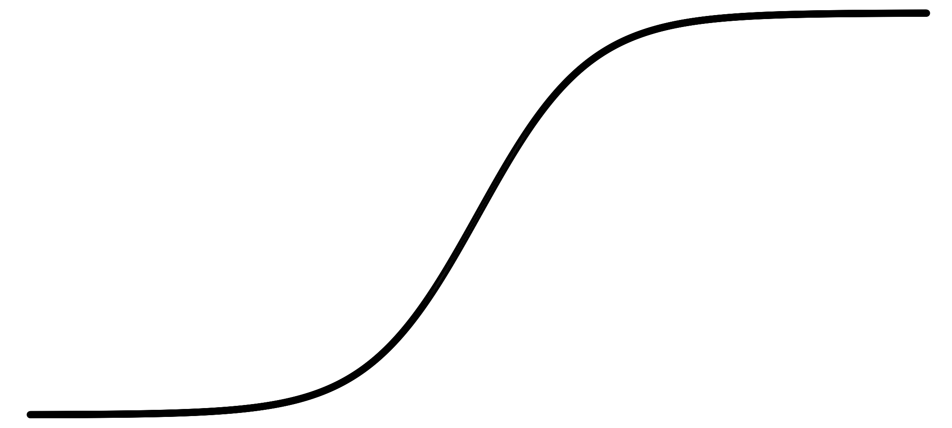
Sigmoid activation function
a
$$g(z)= \frac{1}{1+e^{−z}}$$
z

Slide 3
Tanh activation function
a
$$g(z)=tanh(z){ }$$
z

Slide 4
ReLU and Leaky ReLU
a
a
z
z
ReLU
Leaky ReLU

Slide 5
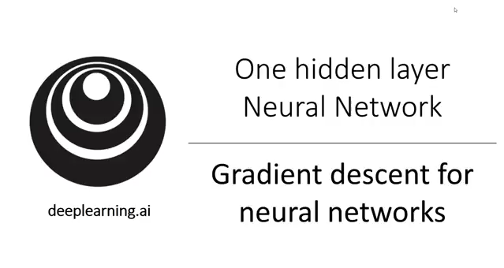
Gradient descent for neural networks

Slide 6
Gradient descent for neural networks

Slide 7
Formulas for computing derivatives

